Slide 1
Git: A Brief Practical
16/06/2020
NB: This practical class assumes the user is running Git from the command line. The concepts apply to GUIs, but the methods will depend on the platform

Slide 2
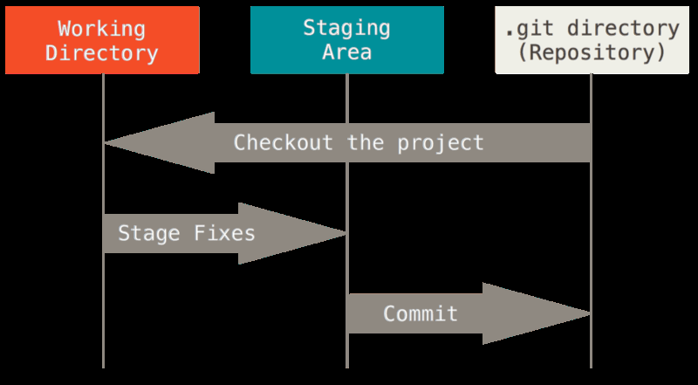
Jargon-Busting
Repository or “Repo” - this is the (hidden) directory (folder) in which the git process is active and the monitoring happens
Commit (Checkin)- This is a “snapshot” git takes of the files whenever a user requests it to
Staging - The process by which files that have been altered or created since the last commit are “marked” for Git to include in the next commit
Checkout - Process of taking a ‘copy’ of the files as they were for a specific commit
Pro Git, Chacon and Straub

Slide 3


My First Repo
Two ways to create a Repo:
Initialise it locally
Navigate to the directory you want to create a git repository and enter the command below
git init
Clone from a remote server
Navigate to the directory where you’d like to clone the repo
git clone [URL]
Try it now
git clone https://github.com/jonvw28/forestecol_gitclass
github.com

Slide 4
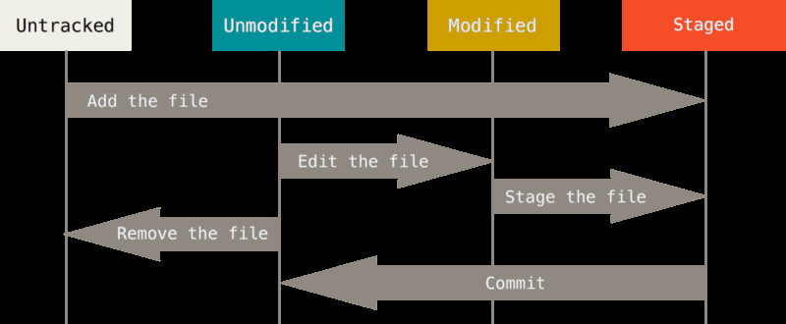
Status of a file
Files can be:
Unmodified - This means they are the same as the version for the commit most recently accessed
Modified - File is being tracked but has been modified. Committing at this point won’t include these changes
Untracked - Git isn’t tracking changes to this file. Committing won’t include this file
Staged - the file has been changed or created since the commit, but committing now will include this file
Pro Git, Chacon and Straub
Commands for the above:
git add [file]
Adds untracked files and stages modified files
git commit
Commits all staged files and creates a snapshot
Now all tracked files will be unmodified with respect to this commit

Slide 5
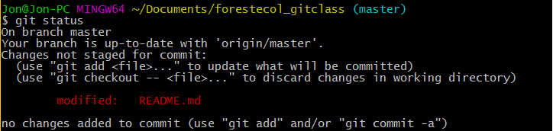
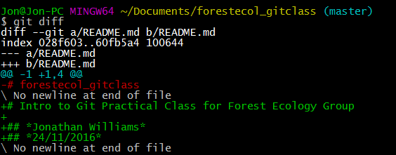
How do I know what’s changed?
Check files
git status
This lists all files that aren’t unmodified along with their status
Check Changes within files
git diff
This shows the actual changes that have occurred line by line (relative to the staged changes)
For more directed uses of git diff look up the function online

Slide 6

How do I create a snapshot?
Make sure all relevant files are staged
git add
git add -A to stage all files
Now commit
git commit
Make sure you include a useful message
Top line should be a clear simple summary of what has changed.
You can then add more detailed paragraphs later
If you want to add the message in the call
git commit -m “message”
If you want to skip git add and do it as part of committing (will include all files)
git commit -a

Slide 7
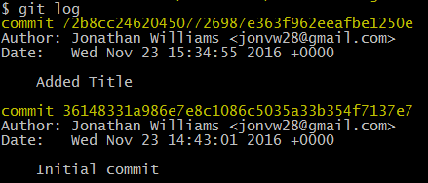
Looking at the History
git log
Shows the history of commits with their comments and unique SHA-1 Checksum
Lots of options for how to display this
See chapter 2 of Pro Git

Slide 8
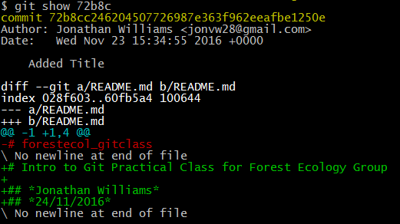

Looking Back
git show [SHA-1]
Shows what a specific commit changed
Can use a short version of the SHA-1 (normally about 5 characters)
git show [SHA-1]:[path to file]
Shows a specific file at the time of given commit

Slide 9

Your turn
Create a new file in the repo from before
Eg jon_w.txt
Check the status of this
git status
Stage it
git add jon_w.txt
Now add some text to the file
Check the status again
git status
Commit your changes (hint: are they staged?)
git add jon_w.txt
git commit
Can you see what README.md looked like before this commit?
git show 044c:README.md

Slide 10
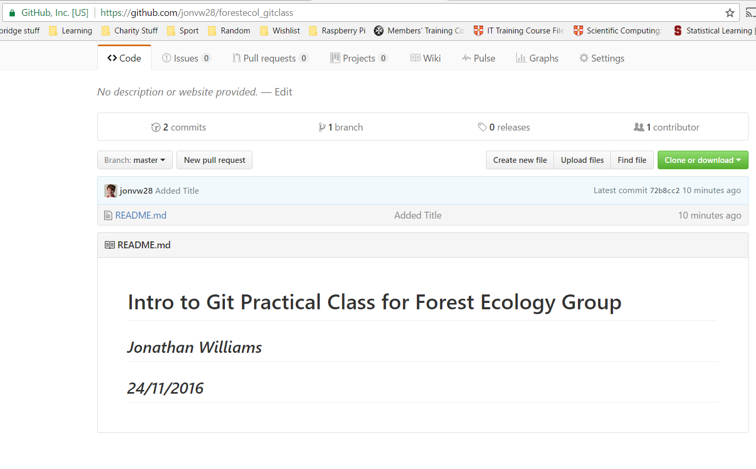
Backing up to Github Server
The real power of Git lies here
There can be one central server which has the ‘official’ copy and then your local copy to work on
You can then update the global copy with your local commits
This is called ‘pushing’
This enables you to have an online copy of your code that can be private or public
Back up if your computer goes kaput
Open-source way to share you code
Really good for papers. You can share specific snippets of code that produce each table and/or figure

Slide 11
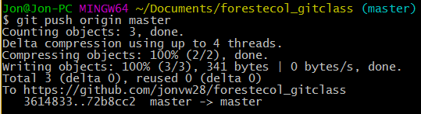
Pushing
git push [external server] [branch]
If repo was initialised on Github and cloned just put origin for the server
If you want to push to elsewhere or this was a local repo use git remote to set other shorthands for URLs
Branching is beyond the time we have today, just put master as the branch for now*
Enable multiple parallel versions of the repo - each one is called a branch
Very useful as two people can work on same repo independently
Eventually we get clashes and so need methods to bring two versions back into one ‘branch’ - see git merge
See Pro Git chapter 3 for more
* the default main branch name is about to change for github

Slide 12
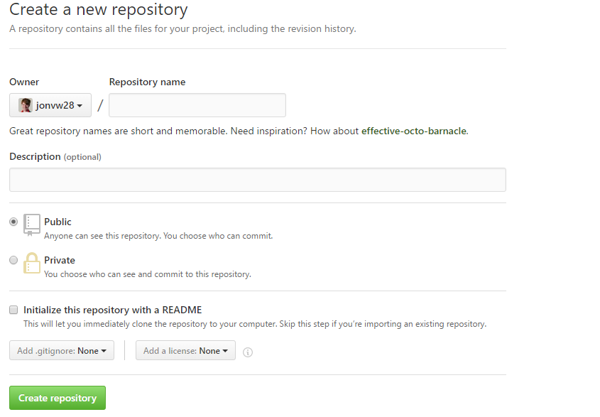
Final Practice
Create a Repo on Github
Check the box that says initialise with README
Clone it to your PC
git clone
Open README.md and add your name
Create a Commit for this change
git add, git commit
Push this commit to the GitHub Repo
git push origin master*
Check Github to see if your name is there!
* since GitHub are about to change the default main branch name this will soon be outdated

Slide 13
Extra Resources
Git Cheat Sheet
Pro Git (THE Git Book) - Free
CRUK intro to Github Workshop
Github 15 Min Intro to Git
Code Academy Git Course (~2hr)
UIS Day Course in Git (free)
Github Education Pack (Free)
Learn Git Branching (More Advanced)

